Slide 1
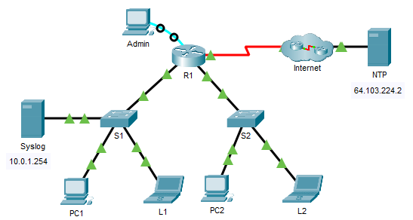
Configure Cisco Devices for Syslog, NTP, and SSH Operations

Slide 2
Configure Cisco Devices for Syslog, NTP, and SSH Operations
In this part, you will access the router R1 via the console port to configure secure remote access SSH. The privileged EXEC password for all the network devices is cisco12345.

Slide 3
    Configure SSH on R1.
    From the Admin PC, click Terminal within the Desktop tab. Click OK to access router R1.
    Set a domain name of your choice on R1.
    Create a user of your choice with a strong encrypted password.
    Generate 1024-bit RSA keys.
    Configure all vty lines for SSH access and use the local user profiles for authentication.
    Set the EXEC mode timeout to 5 minutes on the vty lines.
    Block anyone for five minutes who fails to log in after four attempts within a two-minute period.
    R1(config)# login block-for 600 attempts 4 within 120

Slide 4
Configure Cisco Devices for Syslog, NTP, and SSH Operations
    Verify SSH access.
In this step, you will establish an SSH session to the network devices.
      From the command prompt of another laptop or PC, access S1 via SSH using the username SSHuser and password SSHuserpass.
C:/> ssh -l SSHuser 10.0.1.2
      Repeat and access S2 (10.0.2.2) via SSH using the credentials SSHuser / SSHuserpass.
      From the command prompt of a laptop or PC, access R1 via SSH using the user account configured in the previous step.
      Leave all the established SSH sessions open for NTP and Syslog configurations.

Slide 5
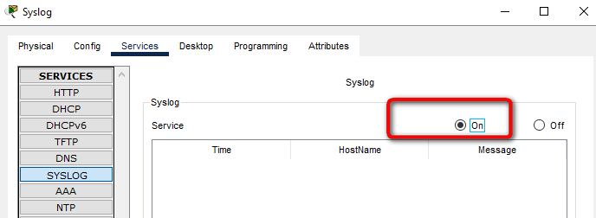
Configure Cisco Devices for Syslog, NTP, and SSH Operations
Configure Syslog Service

Slide 6
    Configure Cisco Devices for Syslog, NTP, and SSH Operations
    Configure the intermediary devices to use the Syslog service.
    From the remote SSH session, configure R1 to send log events to the Syslog server.
    R1(config)# logging 10.0.1.254
    From the remote SSH session, configure S1 to send log events to the Syslog server.
    S1(config)# logging 10.0.1.254
    From the remote SSH session, configure S2 to send log events to the Syslog server.
    S2(config)# logging 10.0.1.254

Slide 7
Configure Cisco Devices for Syslog, NTP, and SSH Operations i tak dalej ……………………………….

Slide 8
Configure Cisco Devices for Syslog, NTP, and SSH Operations rozwiązanie
Router R1 enable config terminal ip domain-name anyname.com username anyusername secret anyusernamepassword line vty 0 4 transport input ssh login local exec-time 5 0 login block-for 600 attempts 4 within 120 crypto key generate rsa general-keys modulus 1024 ntp server 64.103.224.2 service timestamps log datetime msec

Slide 9
Configure Cisco Devices for Syslog, NTP, and SSH Operations rozwiązanie
Switch S1 clock set 13:20:00 Feb 12 2021 enable config terminal service timestamps log datetime msec
Switch S2 clock set 13:20:00 Feb 12 2021 enable config terminal service timestamps log datetime msec

